Slide 1
Feel Him
2026-09-20

Slide 2
1. Overwhelming Awe and Fear
Consider the prophet Ezekiel
Ezekiel 1:28 -2:2 ^{ERV}
  ²⁸The light shining around him was like a rainbow in a cloud. It was the Glory of the Lord. As soon as I saw that, I fell to the ground. I bowed with my face to the ground, and then I heard a voice speaking to me. ¹The voice said, “Son of man, stand up and I will speak with you.” ²Then the Spirit came into me and lifted me up on my feet, and I listened to the one who spoke to me.

Slide 3
1. Overwhelming Awe and Fear
The Disciples
Matthew 17:5–7 ^{ERV}
  ⁵While Peter was talking, a bright cloud came over them. A voice came from the cloud and said, “This is my Son, the one I love. I am very pleased with him. Obey him!” ⁶The followers with Jesus heard this voice. They were very afraid, so they fell to the ground. ⁷But Jesus came to them and touched them. He said, “Stand up. Don’t be afraid.”

Slide 4
1. Overwhelming Awe and Fear
John the Apostle
Revelation 1:17-18 ^{ERV}
  ¹⁷When I saw him, I fell down at his feet like a dead man. He put his right hand on me and said, “Don’t be afraid! I am the First and the Last. ¹⁸I am the one who lives. I was dead, but look, I am alive forever and ever! And I hold the keys of death and Hades”

Slide 5
2. Quiet Spirit
1 Kings 19:11-12 ^{ERV}
  ¹¹Then the Lord said to Elijah, “Go, stand in front of me on the mountain. I, the Lord, will pass by you.” Then a very strong wind blew. The wind caused the mountains to break apart. It broke large rocks in front of the Lord. But that wind was not the Lord. After that wind, there was an earthquake. But that earthquake was not the Lord. ¹²After the earthquake, there was a fire. But that fire was not the Lord. After the fire, there was a quiet, gentle voice.

Slide 6
2. Quiet Spirit
1 Kings 19:13 ^{ERV}
  ¹³When Elijah heard the voice, he used his coat to cover his face and went to the entrance to the cave and stood there.

Slide 7
2. Quiet Spirit
Psalm 46:10 ^{ERV}
  ¹⁰God says, “Stop fighting and know that I am God! I am the one who defeats the nations; I am the one who controls the world.”
Psalm 46:10 ^{MSG}
  ¹⁰“Step out of the traffic! Take a long, loving look at me, your High God, above politics, above everything.”

Slide 8
2. Quiet Spirit
Isaiah 40:31 ^{MSG}
  ³¹But those who wait upon God get fresh strength. They spread their wings and soar like eagles, They run and don’t get tired, they walk and don’t lag behind.

Slide 9
3. Supernatural Peace
Philippians 4:7 ^{ERV}
  ⁷And because you belong to Christ Jesus, God’s peace will stand guard over all your thoughts and feelings. His peace can do this far better than our human minds.

Slide 10
3. Supernatural Peace
John 14:26-27 ^{ERV}
  ²⁶But the Helper will teach you everything and cause you to remember all that I told you. This Helper is the Holy Spirit that the Father will send in my name. ²⁷“I leave you peace. It is my own peace I give you. I give you peace in a different way than the world does. So don’t be troubled. Don’t be afraid.

Slide 11
3. Supernatural Peace
Judges 6:22–24 ^{ERV}
  ²²Then Gideon realized that he had been talking to the angel of the Lord. So he shouted, “Oh, Lord God! I have seen the angel of the Lord face to face!”²³But the Lord said to Gideon, “Calm down! Don’t be afraid! You will not die!” ²⁴So Gideon built an altar there to worship the Lord and named it “The Lord is Peace.”

Slide 12
4. Internal Conviction and Joy
Isaiah 6:5 ^{ERV}
  ⁵I was frightened and said, “Oh, no! I will be destroyed. I am not pure enough to speak to God, and I live among people who are not pure enough to speak to him. But I have seen the King, the Lord All-Powerful.”

Slide 13
4. Internal Conviction and Joy
Luke 5:8 ^{ERV}
  ⁸⁻⁹The fishermen were all amazed at the many fish they caught. When Simon Peter saw this, he bowed down before Jesus and said, “Go away from me, Lord. I am a sinful man!”

Slide 14
4. Internal Conviction and Joy
Psalm 16:11 ^{NKJV}
  ¹¹You will show me the path of life; In Your presence is fullness of joy; At Your right hand are pleasures forevermore.

Slide 15
4. Internal Conviction and Joy
Isaiah 30:21 ^{ERV}
  ²¹If you wander from the right path, either to the right or to the left, you will hear a voice behind you saying, “You should go this way. Here is the right way.”

Slide 16
5. Faith, Not Only Feelings
2 Corinthians 5:7 ^{ERV}
  ⁷We live by what we believe will happen, not by what we can see.

Slide 17
5. Faith, Not Only Feelings
James 4:8 ^{ERV}
  ⁸Come near to God and he will come near to you. You are sinners, so clean sin out of your lives. You are trying to follow God and the world at the same time. Make your thinking pure.

Slide 18
What People Feel
Deep Peace: A sudden calm during a hard time.
Overwhelming Love: A strong sense of being valued and cared for.
Inner Joy: Happiness that does not come from outward things.
Conviction: A quiet, internal nudge to stop doing wrong or to fix a mistake.

Slide 19
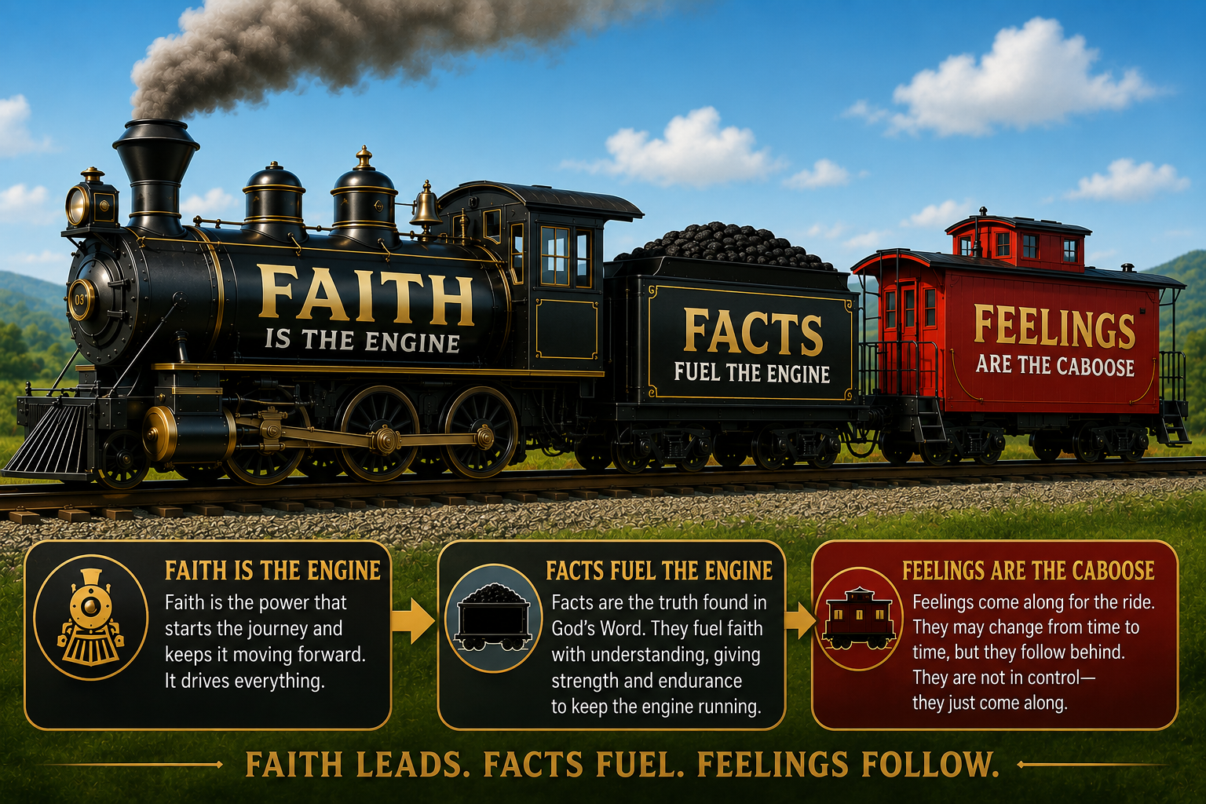
Faith - Facts – Feelings

Slide 20
Feel Him
1. Overwhelming Awe and Fear
  Ezekiel 1:28-2:2, Matthew 17:5-7, Revelation 1:17-18
2. Quiet Spirit
  Psalm 46:10, 1 Kings 19:11-13, Isaiah 40:31
3. Supernatural Peace
  Philippians 4:7, John 14:26-27, Judges 6:22-24
4.Internal Conviction & Joy
  Isaiah 6:5, Luke 5:8, Psalm 16:11, Isaiah 30:21
5. Faith, Not Only Feelings
  2 Corinthians 5:7, James 4:8

