Slide 1
Feel Him
2026-09-20

Slide 2
We continue our series on Experience Jesus with a message I call Feel Him.
This is a dangerous message if you only listen to part of it.
The “religious” will point out that we experience Jesus by faith and that feelings are fickle and cannot be trusted.
Others might see this as a license to chase feelings like those we experience during times of extravagant worship.
I hope to explore both positions this morning.
Let me begin by saying we are too inclined to break the Bible into parts where:

Slide 3
Let me begin by saying we are too inclined to break the Bible into parts where:
God is that Old Testament Deity with anger issues.
Jesus is the “nice guy” hippy of the Gospels.
Holy Spirit is the wild magician character in Acts.
Truth is, God is all over the Bible and He is one God and we cannot speak about Experiencing Jesus without experiencing God because Jesus is God.
Jesus himself said “I and the Father are one” John 10:30
Jesus also said “The Spirit of the Lord is on me” Luke 4:18
Jesus is just as present in the Old Testament as the Gospels and throughout the whole New Testament.

Slide 4
Jesus is just as present in the Old Testament as the Gospels and throughout the whole New Testament.
The Bible teaches that sensing God’s presence is a real experience, but it describes this awareness in several distinct ways.
It emphasizes that while emotions and physical signs can happen, God’s presence is primarily known through faith, peace, and a changed heart.
Here is how the Bible outlines sensing God's presence:

Slide 5
Consider the priest Ezekiel
You would think a priest would be used to experiencing God and hearing His voice.
But when he was in exile to Babylon he saw a vision of the glory of God and immediately fell face down on the ground in awe.
Overwhelming Awe and Fear
Ezekiel 1:28 -2:2 ^{ERV}

Slide 6
1. Overwhelming Awe and Fear
Ezekiel 1:28 -2:2 ^{ERV}
  ²⁸The light shining around him was like a rainbow in a cloud. It was the Glory of the Lord. As soon as I saw that, I fell to the ground. I bowed with my face to the ground, and then I heard a voice speaking to me. ¹The voice said, “Son of man, stand up and I will speak with you.” ²Then the Spirit came into me and lifted me up on my feet, and I listened to the one who spoke to me.
Before you say “That was Old Testament” consider the disciples.

Slide 7
Before you say “That was Old Testament” consider the disciples.
During the Transfiguration, when God’s voice spoke from a bright cloud, Peter, James, and John fell face down, gripped by terror.
Matthew 17:5–6

Slide 8
1. Overwhelming Awe and Fear
Matthew 17:5–7 ^{ERV}
  ⁵While Peter was talking, a bright cloud came over them. A voice came from the cloud and said, “This is my Son, the one I love. I am very pleased with him. Obey him!” ⁶The followers with Jesus heard this voice. They were very afraid, so they fell to the ground. ⁷But Jesus came to them and touched them. He said, “Stand up. Don’t be afraid.”
I know what you are thinking, that was still Father God. But what about John?

Slide 9
I know what you are thinking, that was still Father God. But what about John?
John was one of the disciples and spent 3 years with Jesus.
After His resurrection, John was with Him off and on for 40 days even eating with Him.
Yet, look at what John wrote in the Book of Revelation.
Revelation 1:17

Slide 10
1. Overwhelming Awe and Fear
Revelation 1:17-18 ^{ERV}
  ¹⁷When I saw him, I fell down at his feet like a dead man. He put his right hand on me and said, “Don’t be afraid! I am the First and the Last. ¹⁸I am the one who lives. I was dead, but look, I am alive forever and ever! And I hold the keys of death and Hades”

Slide 11
God often reveals His presence in quiet moments of stillness.
Sensing Him often requires slowing down and silencing internal and external noise.
Consider Elijah.
After defeating the prophets of Baal, Elijah ran for his life from Ahab and wicked queen Jezebel ending up in a cave on Mount Horeb, the mountain of God.
God speaks to him there.
That’s 2. Quiet Spirit
Let pick up the story in 1 Kings 19:11-13

Slide 12
2. Quiet Spirit
1 Kings 19:11-12 ^{ERV}
  ¹¹Then the Lord said to Elijah, “Go, stand in front of me on the mountain. I, the Lord, will pass by you.” Then a very strong wind blew. The wind caused the mountains to break apart. It broke large rocks in front of the Lord. But that wind was not the Lord. After that wind, there was an earthquake. But that earthquake was not the Lord. ¹²After the earthquake, there was a fire. But that fire was not the Lord. After the fire, there was a quiet, gentle voice.
Where was God?

Slide 13
Where was God?
After experiencing a terrifying wind, earthquake, and fire, Elijah recognized God’s presence in a quiet, gentle voice.
God was not IN the powerful wind, the earthquake, or the fire.
He made them, but was not IN them.
Instead, Elijah sensed God in a "gentle whisper" or a still, small voice.
His reaction was to wrap his face in his cloak and stand quietly at the mouth of a cave, ready to listen.
Let’s continue with 1 Kings 19:13 ERV

Slide 14
2. Quiet Spirit
1 Kings 19:13 ^{ERV}
  ¹³When Elijah heard the voice, he used his coat to cover his face and went to the entrance to the cave and stood there.
Some of you may be familiar with the passage which instructs us to, "Be still, and know that I am God."
Psalm 46:10 reads a little differently in the ERV and MSG versions.

Slide 15
2. Quiet Spirit
Psalm 46:10 ^{ERV}
  ¹⁰God says, “Stop fighting and know that I am God! I am the one who defeats the nations; I am the one who controls the world.”
Psalm 46:10 ^{MSG}
  ¹⁰“Step out of the traffic! Take a long, loving look at me, your High God, above politics, above everything.”
You may be familiar with the scripture that’s instructs us to “wait on the Lord”
Isaiah 40:31 ^{MSG}

Slide 16
2. Quiet Spirit
Isaiah 40:31 ^{MSG}
  ³¹But those who wait upon God get fresh strength. They spread their wings and soar like eagles, They run and don’t get tired, they walk and don’t lag behind.
WAIT – In Hebrew means to bind together (perhaps by twisting), gather (together), look, patiently, tarry, wait (for, on, upon).
Think of being in a 3-legged race with God “bound” to you. You need to stay in step and in sync with Him to move forward.
3. Supernatural Peace
Surpassing Understanding:

Slide 17
3. Supernatural Peace
Surpassing Understanding:
One of the most common biblical indicators of God's presence is an inexplicable sense of calm during difficult times.
Philippians 4:7 promises "God’s peace."

Slide 18
3. Supernatural Peace
Philippians 4:7 ^{ERV}
  ⁷And because you belong to Christ Jesus, God’s peace will stand guard over all your thoughts and feelings. His peace can do this far better than our human minds.
This means feeling calm even when your logical circumstances say you should be worried.
This is ONLY possible because Jesus sent the Holy Spirit to us.
The Comforter:
Jesus refers to the Holy Spirit as the "Helper" or "Comforter" sent to bring emotional and spiritual relief. See in John 14:26-27

Slide 19
3. Supernatural Peace
John 14:26-27 ^{ERV}
  ²⁶But the Helper will teach you everything and cause you to remember all that I told you. This Helper is the Holy Spirit that the Father will send in my name. ²⁷“I leave you peace. It is my own peace I give you. I give you peace in a different way than the world does. So don’t be troubled. Don’t be afraid.
When God appeared to comfort or reassure someone, the reaction shifted from terror to deep rest, relief, and obedience.

Slide 20
3. Supernatural Peace
Consider Gideon:
Israel was oppressed by the Midianites and an Angel visited Gideon to inform him he was going to be their deliverer.
When Gideon realized he was speaking directly to the Angel of the Lord (Judges 6:22–24), he panicked, fearing death.
God responded, "Peace! Do not be afraid." Gideon’s fear instantly vanished, and he built an altar named "The Lord is Peace."
Judges 6:22–24 ^{ERV}

Slide 21
3. Supernatural Peace
Judges 6:22–24 ^{ERV}
  ²²Then Gideon realized that he had been talking to the angel of the Lord. So he shouted, “Oh, Lord God! I have seen the angel of the Lord face to face!”²³But the Lord said to Gideon, “Calm down! Don’t be afraid! You will not die!” ²⁴So Gideon built an altar there to worship the Lord and named it “The Lord is Peace.”
I should mention that many scholars believe that when the Bible speaks of “The Angel of the Lord”, it is referring to the pre-incarnate Jesus.
4. Internal Conviction and Joy

Slide 22
4. Internal Conviction and Joy
Sensing a perfect, holy God often caused characters to instantly see their own imperfections, leading to deep humility and repentance.
Like Isaiah

Slide 23
4. Internal Conviction and Joy
Isaiah:
When Isaiah sensed God in the temple (Isaiah 6:5), he did not feel happy or comforted first.
Instead, he cried out in fear.
Isaiah 6:5 ^{ERV}
  ⁵I was frightened and said, “Oh, no! I will be destroyed. I am not pure enough to speak to God, and I live among people who are not pure enough to speak to him. But I have seen the King, the Lord All-Powerful.”

Slide 24
4. Internal Conviction and Joy
Peter:
After witnessing a miraculous catch of fish and realizing Jesus' divine power (Luke 5:8), Peter fell at Jesus’ knees.
Luke 5:8 ^{ERV}
  ⁸⁻⁹The fishermen were all amazed at the many fish they caught. When Simon Peter saw this, he bowed down before Jesus and said, “Go away from me, Lord. I am a sinful man!”

Slide 25
4. Internal Conviction and Joy
Fullness of Joy:
Psalm 16:11 promises joy.
Psalm 16:11 ^{NKJV}
  ¹¹You will show me the path of life; In Your presence is fullness of joy; At Your right hand are pleasures forevermore.

Slide 26
4. Internal Conviction and Joy
A Gentle Nudge:
In Isaiah 30:21, the Bible describes hearing a voice behind you giving instructions, which represents the Holy Spirit guiding your conscience.
Isaiah 30:21 ^{ERV}
  ²¹If you wander from the right path, either to the right or to the left, you will hear a voice behind you saying, “You should go this way. Here is the right way.”

Slide 27
5. Faith, Not Only Feelings
The Bible balances the desire to "feel" God with the command to trust Him even when He feels distant.
Walking by Faith:
2 Corinthians 5:7 says, "We walk by faith, not by sight" (or by raw emotion).
2 Corinthians 5:7 ^{ERV}
  ⁷We live by what we believe will happen, not by what we can see.

Slide 28
5. Faith, Not Only Feelings
Unconditional Closeness:
James 4:8 promises that God will “draw near to you."
The Bible emphasizes that God is present based on His promise, whether a person actively feels an emotional rush or not.
James 4:8 ^{ERV}
  ⁸Come near to God and he will come near to you. You are sinners, so clean sin out of your lives. You are trying to follow God and the world at the same time. Make your thinking pure.

Slide 29
What People Feel
Deep Peace: A sudden calm during a hard time.
Overwhelming Love: A strong sense of being valued and cared for.
Inner Joy: Happiness that does not come from outward things.
Conviction: A quiet, internal nudge to stop doing wrong or to fix a mistake.

Slide 30
So what does this all mean?
To Feel Jesus may be different for different people.
After all, God made us unique and it just stands to reason that He will feel uniquely different to each of us.
We know that men and women “feel” things differently.
God is so amazing and powerful that He can create a custom experience for each of His children.
Don’t despair if your experience differs from someone else.
Lean in to Jesus and allow Him to lean into you.
Don’t put all your trust in feelings.

Slide 31
Don’t put all your trust in feelings.
Unchecked feelings can lead us astray
God uses positive feelings to enrich our lives.
God uses negative feelings to warn us of a need to change something.
But feelings are not what move us forward.
We need faith.
Let me end with this illustration.
Faith - Facts – Feelings

Slide 32
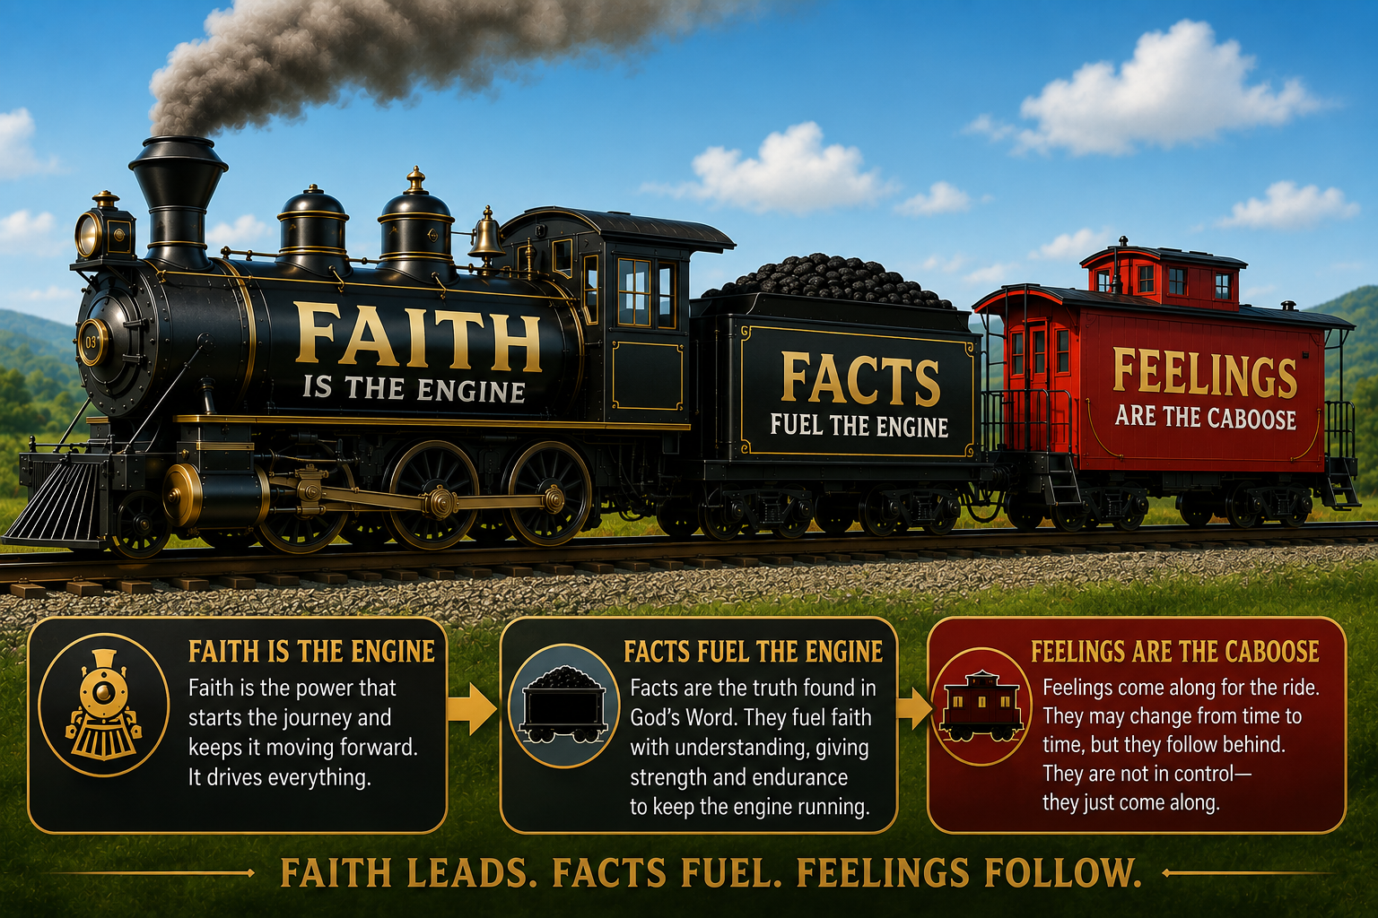
Faith - Facts – Feelings
Without faith, the train does not move.

Slide 33
Without faith, the train does not move.
Faith must be fueled by facts.
  Faith in falsehood (rocks not coal) has no power
All the feelings in the world will not fuel the engine
  Faith in feelings lacks power also
God’s Word is fact. God’s love is fact.
  Only faith in God has the power to move you forward.
Only through TRUE faith can we “Experience Jesus”

Slide 34
Feel Him
1. Overwhelming Awe and Fear
  Ezekiel 1:28-2:2, Matthew 17:5-7, Revelation 1:17-18
2. Quiet Spirit
  Psalm 46:10, 1 Kings 19:11-13, Isaiah 40:31
3. Supernatural Peace
  Philippians 4:7, John 14:26-27, Judges 6:22-24
4.Internal Conviction & Joy
  Isaiah 6:5, Luke 5:8, Psalm 16:11, Isaiah 30:21
5. Faith, Not Only Feelings
  2 Corinthians 5:7, James 4:8

