Slide 1
Teacher But Not Scary
08-16-2026

Slide 2
I. HOLY SPIRIT TEACHES US ABOUT GOD
Romans 5:1-5 ^{VOICE}
  ¹Since we have been acquitted and made right through faith, we are able to experience true and lasting peace with God through our Lord Jesus, the Anointed One, the Liberating King. ²Jesus leads us into a place of radical grace where we are able to celebrate the hope of experiencing God’s glory. ³And that’s not all. We also celebrate in seasons of suffering because we know that when we suffer we develop endurance, ⁴which shapes our characters. When our characters are refined, we learn what it means to hope and anticipate God’s goodness. ⁵And hope will never fail to satisfy our deepest need because the Holy Spirit that was given to us has flooded our hearts with God’s love.

Slide 3
I. HOLY SPIRIT TEACHES US ABOUT GOD
Romans 8:14-17 ^{VOICE}
  ¹⁴If the Spirit of God is leading you, then take comfort in knowing you are His children. ¹⁵You see, you have not received a spirit that returns you to slavery, so you have nothing to fear. The Spirit you have received adopts you and welcomes you into God’s own family. That’s why we call out to Him, “Abba! Father!” as we would address a loving daddy. ¹⁶Through that prayer, God’s Spirit confirms in our spirits that we are His children. ¹⁷If we are God’s children, that means we are His heirs along with the Anointed, set to inherit everything that is His. If we share His sufferings, we know that we will ultimately share in His glory.

Slide 4
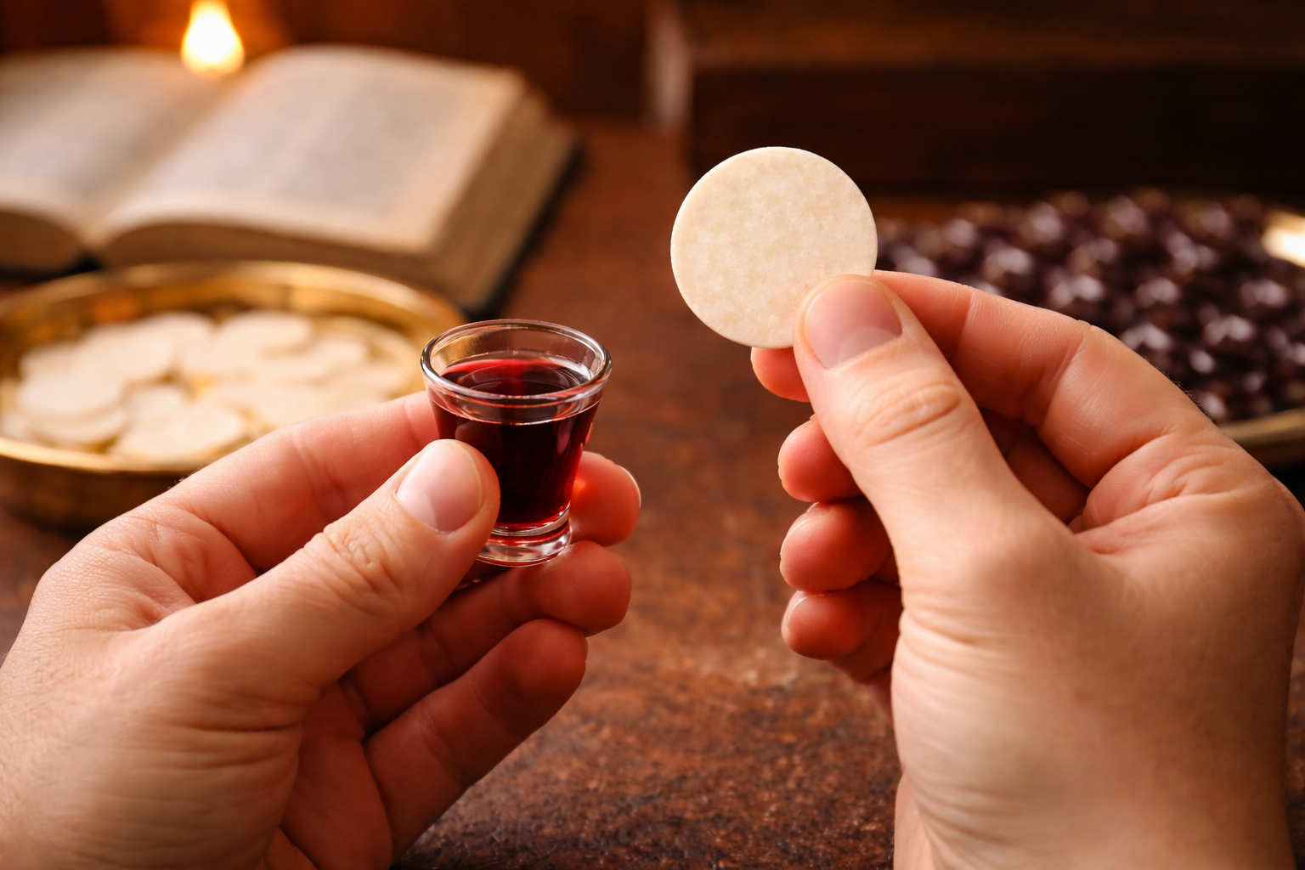
Family Communion

Slide 5
II. HOLY SPIRIT TEACHES US ABOUT JESUS
John 15:26-27 ^{VOICE}
  ²⁶I will send a great Helper to you from the Father, one known as the Spirit of truth. He comes from the Father and will point to the truth as it concerns Me. ²⁷But you will also point others to the truth about My identity, because you have journeyed with Me since this all began.

Slide 6
II. HOLY SPIRIT TEACHES US ABOUT JESUS
John 16:12-15 ^{VOICE}
  ¹²I have so much more to say, but you cannot absorb it right now. ¹³⁻¹⁵ The Spirit of truth will come and guide you in all truth. He will not speak His own words to you; He will speak what He hears, revealing to you the things to come and bringing glory to Me. The Spirit has unlimited access to Me, to all that I possess and know, just as everything the Father has is Mine. That is the reason I am confident He will care for My own and reveal the path to you.

Slide 7
III. HOLY SPIRIT TEACHES US ABOUT OUR NEW WAY OF LIFE
Romans 8:9-11 ^{VOICE}
  ⁹But you do not live in the flesh. You live in the Spirit, assuming, of course, that the Spirit of God lives inside of you. The truth is that anyone who does not have the Spirit of the Anointed living within does not belong to God. ¹⁰ If the Anointed One lives within you, even though the body is as good as dead because of the effects of sin, the Spirit is infusing you with life now that you are right with God. ¹¹ If the Spirit of the One who resurrected Jesus from the dead lives inside of you, then you can be sure that He who raised Him will cast the light of life into your mortal bodies through the life-giving power of the Spirit residing in you.

Slide 8
III. HOLY SPIRIT TEACHES US ABOUT OUR NEW WAY OF LIFE
Galatians 5:16-18 ^{VOICE}
  ¹⁶Here’s my instruction: walk in the Spirit, and let the Spirit bring order to your life. If you do, you will never give in to your selfish and sinful cravings. ¹⁷For everything the flesh desires goes against the Spirit, and everything the Spirit desires goes against the flesh. There is a constant battle raging between them that prevents you from doing the good you want to do. ¹⁸But when you are led by the Spirit, you are no longer subject to the law.

Slide 9
III. HOLY SPIRIT TEACHES US ABOUT OUR NEW WAY OF LIFE
Galatians 5:22-26 ^{VOICE}
  ²²The Holy Spirit produces a different kind of fruit: unconditional love, joy, peace, patience, kindheartedness, goodness, faithfulness, ²³gentleness, and self-control. You won’t find any law opposed to fruit like this. ²⁴Those of us who belong to the Anointed One have crucified our old lives and put to death the flesh and all the lusts and desires that plague us. ²⁵Now since we have chosen to walk with the Spirit, let’s keep each step in perfect sync with God’s Spirit. ²⁶This will happen when we set aside our self-interests and work together to create true community instead of a culture consumed by provocation, pride, and envy.

Slide 10
Teacher But Not Scary
I. HOLY SPIRIT TEACHES US ABOUT GOD
II. HOLY SPIRIT TEACHES US ABOUT JESUS
III. HOLY SPIRIT TEACHES US ABOUT OUR NEW WAY OF LIFE

