Slide 1
The Power Factor
06-14-26

Slide 2
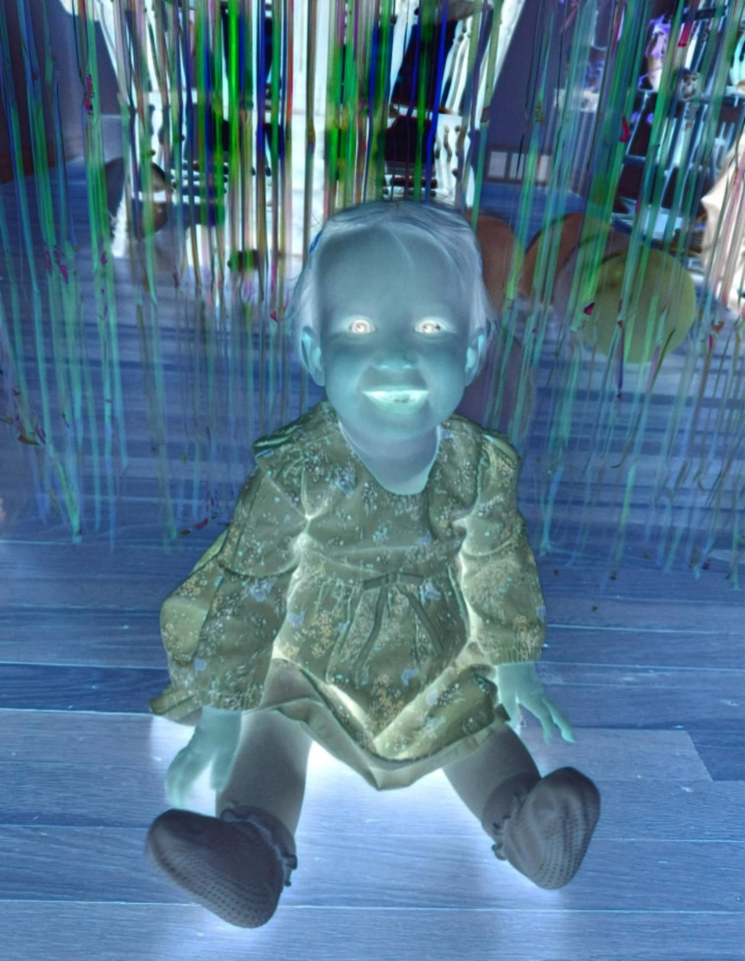
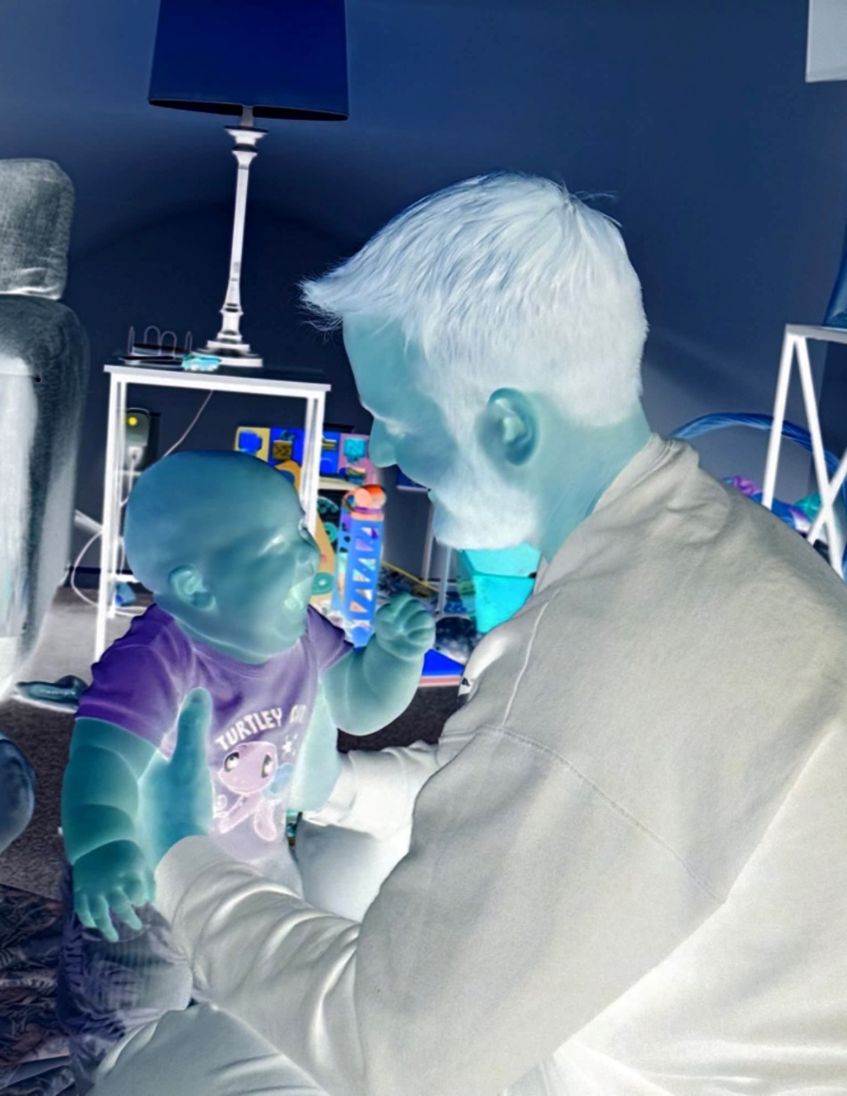
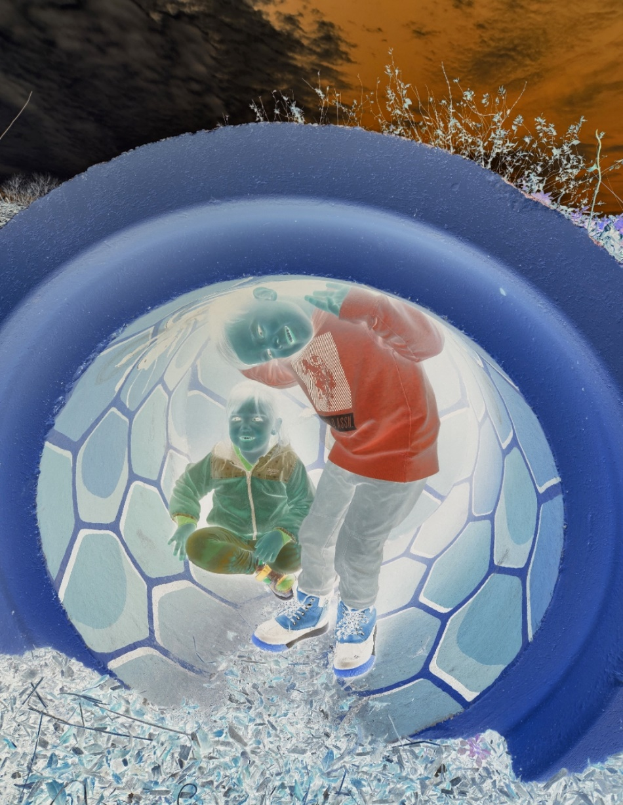

Slide 3
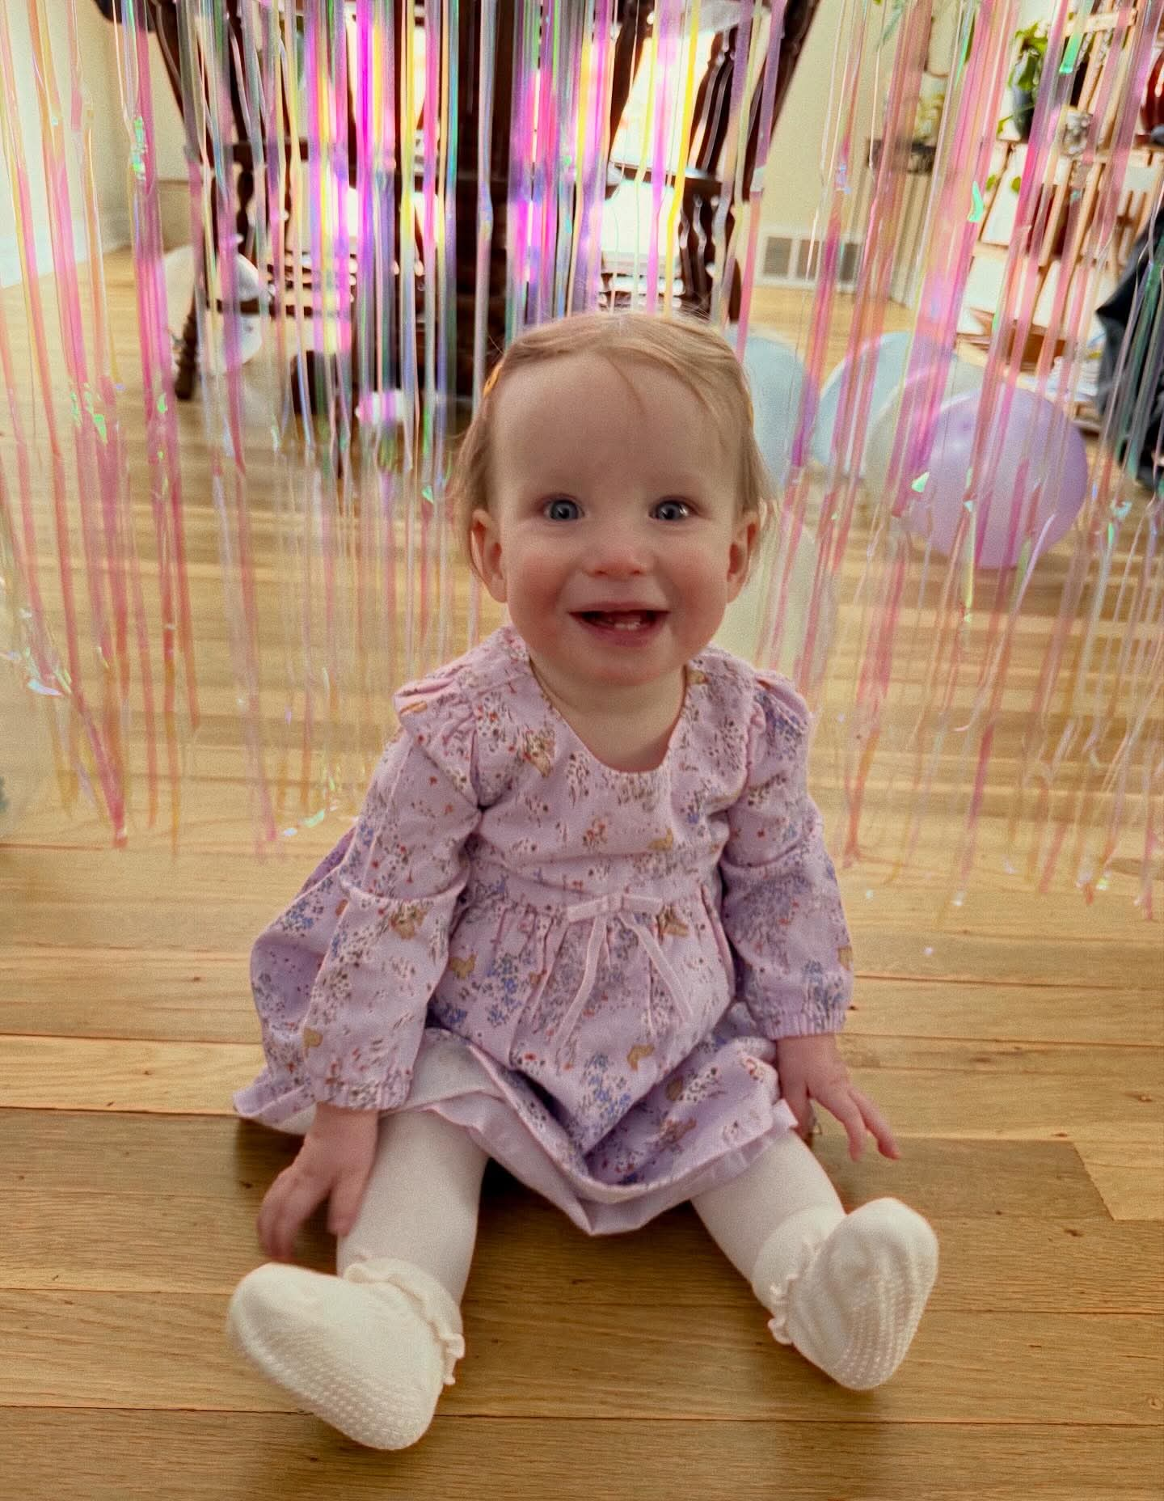
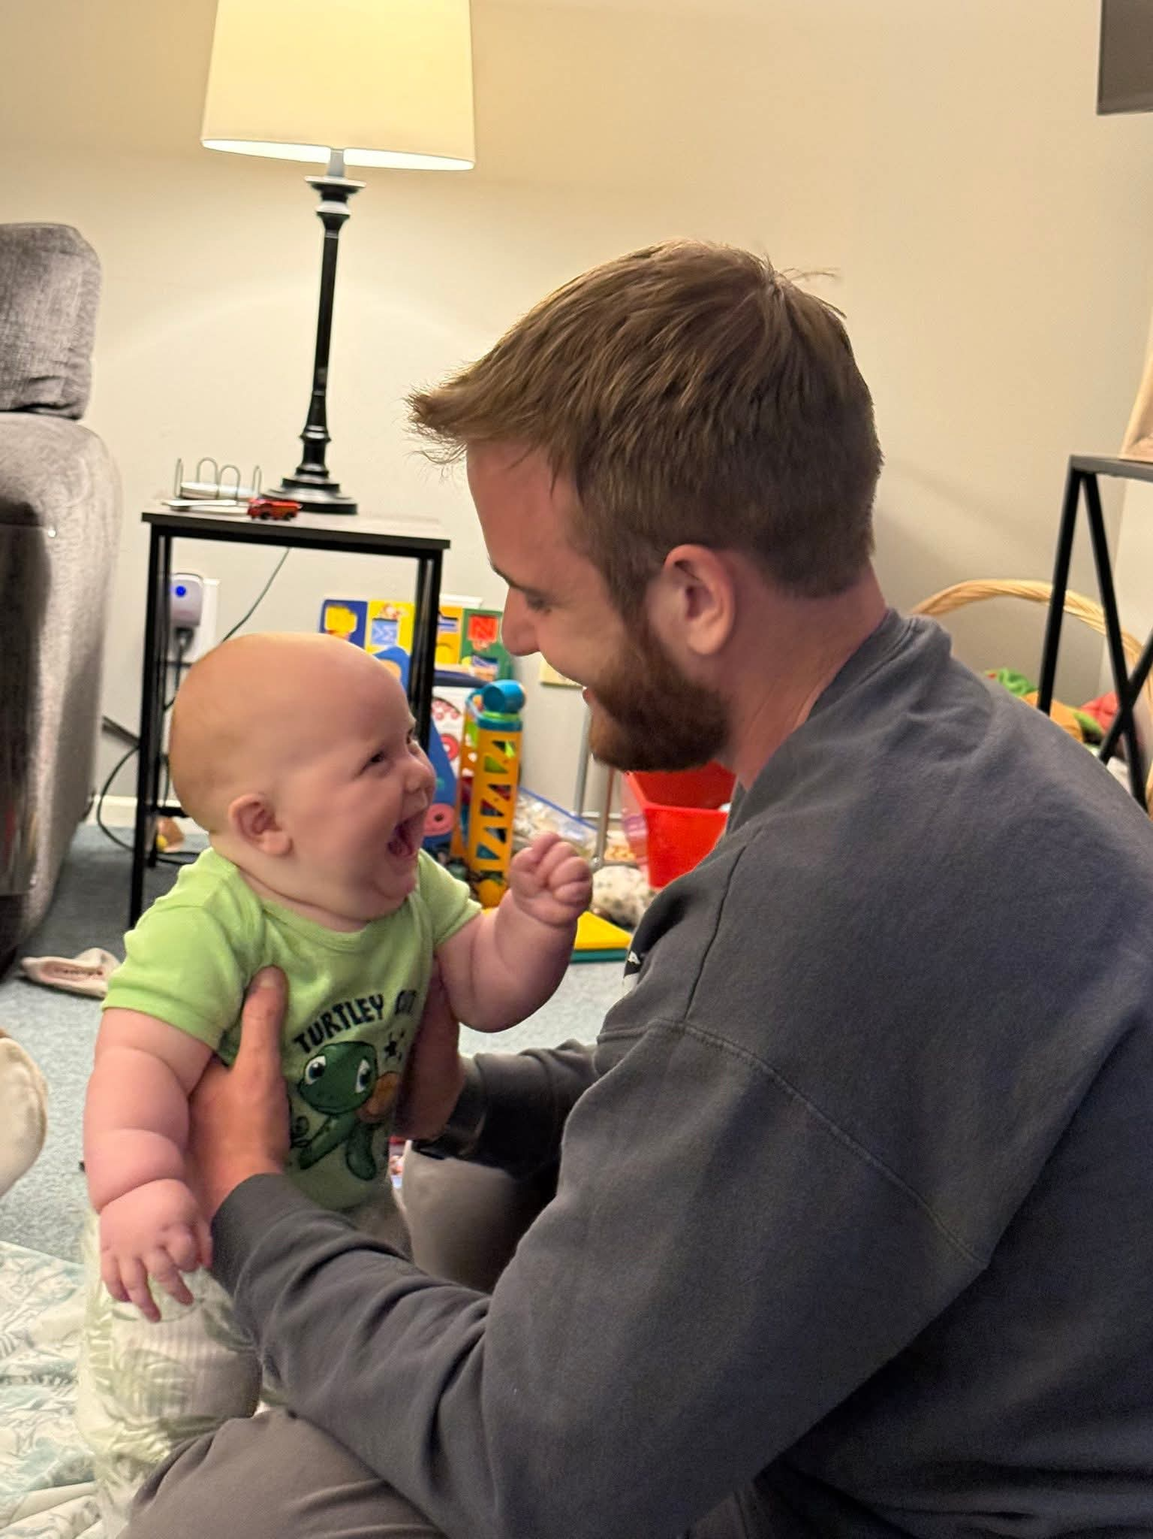


Slide 4
I. THE POWER OF HUMILITY
I Samuel 30:1-8 ^{NLT}
  ¹Three days later, when David and his men arrived home at their town of Ziklag, they found that the Amalekites had made a raid into the Negev and Ziklag; they had crushed Ziklag and burned it to the ground. ²They had carried off the women and children and everyone else but without killing anyone. ³When David and his men saw the ruins and realized what had happened to their families, ⁴they wept until they could weep no more.

Slide 5
I. THE POWER OF HUMILITY
I Samuel 30:1-8 ^{NLT}
  ⁵David’s two wives, Ahinoam from Jezreel and Abigail, the widow of Nabal from Carmel, were among those captured. ⁶David was now in great danger because all his men were very bitter about losing their sons and daughters, and they began to talk of stoning him. But David found strength in the Lord his God.

Slide 6
I. THE POWER OF HUMILITY
I Samuel 30:1-8 ^{NLT}
  ⁷Then he said to Abiathar the priest, “Bring me the ephod!” So Abiathar brought it. ⁸Then David asked the Lord, “Should I chase after this band of raiders? Will I catch them?” And the Lord told him, “Yes, go after them. You will surely recover everything that was taken from you!”
    A. Humility to See God Accurately
    B. Humility to See Myself Accurately
    C. Humility to Submit to God’s Ways

Slide 7

Family Communion

Slide 8
The Power Factor
I. THE POWER OF HUMILITY
    A. Humility to See God Accurately
    B. Humility to See Myself Accurately
    C. Humility to Submit to God’s Ways

