Slide 1
The Door Stop
05-03-26

Slide 2
Mark 10:17 ^{ERV}
¹⁷Jesus started to leave, but a man ran to him and bowed down on his knees before him...

Slide 3
Mark 10:13-14 ^{ERV}
¹³People brought their small children to Jesus so that he could lay his hands on them to bless them. But the followers told the people to stop bringing their children to him. ¹⁴Jesus saw what happened. He did not like his followers telling the children not to come. So he said to them, “Let the little children come to me. Don’t stop them, because God’s kingdom belongs to people who are like these little children.

Slide 4
Mark 10:15-16 ^{ERV}
¹⁵The truth is, you must accept God’s kingdom like a little child accepts things, or you will never enter it.” ¹⁶Then Jesus held the children in his arms. He laid his hands on them and blessed them.

Slide 5
Mark 10:17 ^{ERV}
¹⁷Jesus started to leave, but a man ran to him and bowed down on his knees before him. The man asked, “Good Teacher, what must I do to get the life that never ends?”

Slide 6
Mark 10:18-19 ^{ERV}
¹⁸Jesus answered, “Why do you call me good? Only God is good. ¹⁹And you know his commands: ‘You must not murder anyone, you must not commit adultery, you must not steal, you must not lie, you must not cheat, you must respect your father and mother ….’”

Slide 7
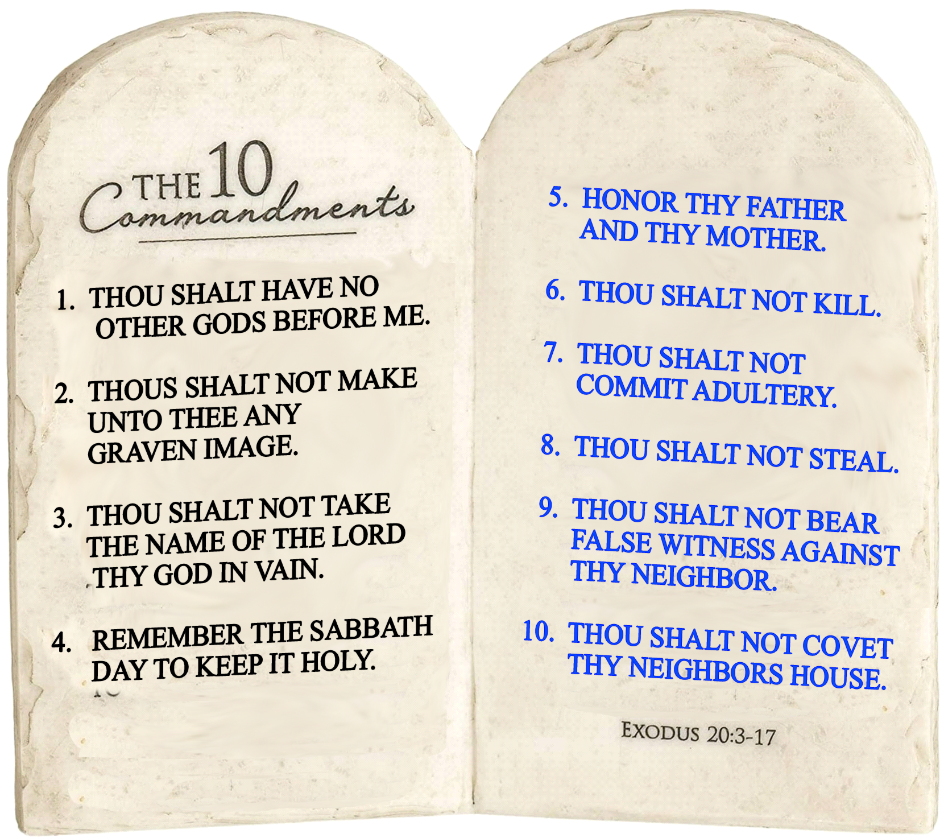

Slide 8
Mark 10:20-21 ^{ERV}
²⁰The man said, “Teacher, I have obeyed all these commands since I was a boy.” ²¹Jesus looked at the man in a way that showed how much he cared for him. He said, “There is still one thing you need to do. Go and sell everything you have. Give the money to those who are poor, and you will have riches in heaven. Then come and follow me.”

Slide 9
Mark 10:22 ^{ERV}
²²The man was upset when Jesus told him to give away his money. He didn’t want to do this, because he was very rich. So he went away sad.

Slide 10
Mark 10:23-27 ^{ERV}
²³Then Jesus looked at his followers and said to them, “It will be very hard for a rich person to enter God’s kingdom!” ²⁴The followers were amazed at what Jesus said. But he said again, “My children, it is very hard to enter God’s kingdom! ²⁵It is easier for a camel to go through the eye of a needle than for a rich person to enter God’s kingdom!” ²⁶The followers were even more amazed and said to each other, “Then who can be saved?” ²⁷Jesus looked at them and said, “That is something people cannot do, but God can. He can do anything.”

Slide 11

Key Truth
The Kingdom of God is not something you add to your life—it’s something you give your life to.

Slide 12
Mark 10:28-30 ^{ERV}
²⁸Peter said to Jesus, “We left everything to follow you!” ²⁹Jesus said, “I can promise that everyone who has left their home, brothers, sisters, mother, father, children, or farm for me and for the Good News about me ³⁰will get a hundred times more than they left. Here in this world they will get more homes, brothers, sisters, mothers, children, and farms. And with these things they will have persecutions. But in the world that is coming they will also get the reward of eternal life.

Slide 13
The Door Stop
What is stopping me at the door?
What is keeping me from full surrender?
Am I adding Him to my life rather than giving Him my life?
What do I have to lose?
What do I stand to gain?
What would “ALL IN” actually look like for me right now?

