Slide 1
From Doubt To Declaration
04-12-26

Slide 2
John 11:8-10 ^{MSG}
They said, “Rabbi, you can’t do that. The Jews are out to kill you, and you’re going back?” Jesus replied, “Are there not twelve hours of daylight? Anyone who walks in daylight doesn’t stumble because there’s plenty of light from the sun. Walking at night, he might very well stumble because he can’t see where he’s going.”

Slide 3
John 11:11-13 ^{MSG}
He said these things, and then announced, “Our friend Lazarus has fallen asleep. I’m going to wake him up.” The disciples said, “Master, if he’s gone to sleep, he’ll get a good rest and wake up feeling fine.” Jesus was talking about death, while his disciples thought he was talking about taking a nap.

Slide 4
John 11:14-16 ^{MSG}
Then Jesus became explicit: “Lazarus died. And I am glad for your sakes that I wasn’t there. You’re about to be given new grounds for believing. Now let’s go to him.” That’s when Thomas, the one called the Twin, said to his companions, “Come along. We might as well die with him.”

Slide 5
John 13:36-38 ^{MSG}
³⁶Simon Peter asked, “Master, just where are you going?” Jesus answered, “You can’t now follow me where I’m going. You will follow later.” ³⁷“Master,” said Peter, “why can’t I follow now? I’ll lay down my life for you!” ³⁸“Really? You’ll lay down your life for me? The truth is that before the rooster crows, you’ll deny me three times.”

Slide 6
John 14:1-4 ^{MSG}
Don’t let this rattle you. You trust God, don’t you? Trust me. There is plenty of room for you in my Father’s home. If that weren’t so, would I have told you that I’m on my way to get a room ready for you? And if I’m on my way to get your room ready, I’ll come back and get you so you can live where I live. And you already know the road I’m taking.”

Slide 7
John 14:5-7 ^{MSG}
Thomas said, “Master, we have no idea where you’re going. How do you expect us to know the road?” Jesus said, “I am the Road, also the Truth, also the Life. No one gets to the Father apart from me. If you really knew me, you would know my Father as well. From now on, you do know him. You’ve even seen him!”

Slide 8
John 20:24-25 ^{MSG}
But Thomas, sometimes called the Twin, one of the Twelve, was not with them when Jesus came. The other disciples told him, “We saw the Master.” But he said, “Unless I see the nail holes in his hands, put my finger in the nail holes, and stick my hand in his side, I won’t believe it.”

Slide 9
John 20:26-27 ^{MSG}
Eight days later, his disciples were again in the room. This time Thomas was with them. Jesus came through the locked doors, stood among them, and said, “Peace to you.” Then he focused his attention on Thomas. “Take your finger and examine my hands. Take your hand and stick it in my side. Don’t be unbelieving. Believe.”

Slide 10
John 20:28-29 ^{MSG}
Thomas said, “My Master! My God!” Jesus said, “So, you believe because you’ve seen with your own eyes. Even better blessings are in store for those who believe without seeing.”

Slide 11
John 21:1-3 ^{MSG}
After this, Jesus appeared again to the disciples, this time at the Tiberias Sea (the Sea of Galilee). This is how he did it: Simon Peter, Thomas (nicknamed “Twin”), Nathanael from Cana in Galilee, the brothers Zebedee, and two other disciples were together. Simon Peter announced, “I’m going fishing.” The rest of them replied, “We’re going with you.” They went out and got in the boat. They caught nothing that night. When the sun came up, Jesus was standing on the beach, but they didn’t recognize him.

Slide 12
Acts 1:12-14 ^{MSG}
So they left the mountain called Olives and returned to Jerusalem. It was a little over half a mile. They went to the upper room they had been using as a meeting place: Peter, John, James, Andrew, Philip, Thomas, Bartholomew, Matthew, James, son of Alphaeus, Simon the Zealot, Judas, son of James. They agreed they were in this for good, completely together in prayer, the women included. Also Jesus’ mother, Mary, and his brothers.

Slide 13
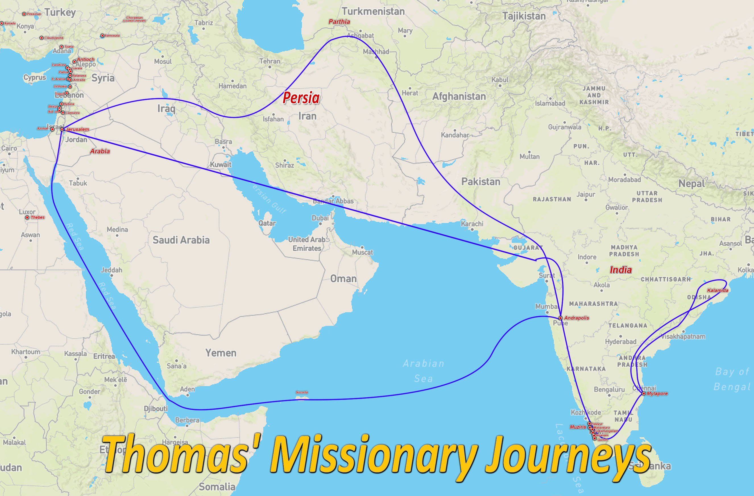

Slide 14

From Doubt to Declaration
Thomas wasn’t just a doubter—he demonstrated:
1. Bold Loyalty
2. Thoughtful Questioning
3. Sincere Declaration
4. Courageous Evangelism
The loudest worship often comes from former doubters.

