Slide 1
Class of 2026
Oak River Church

Slide 2
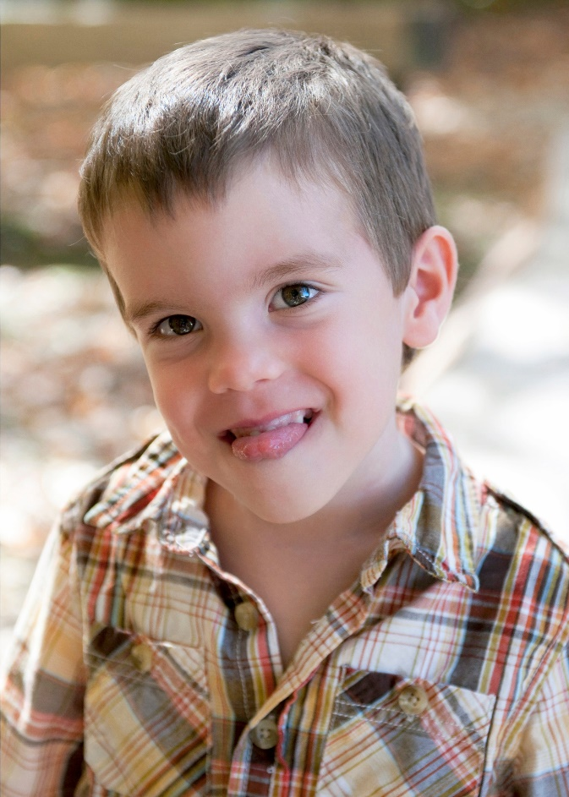
Christian
Schuller
Bowling Green State University
Business Management

Slide 3
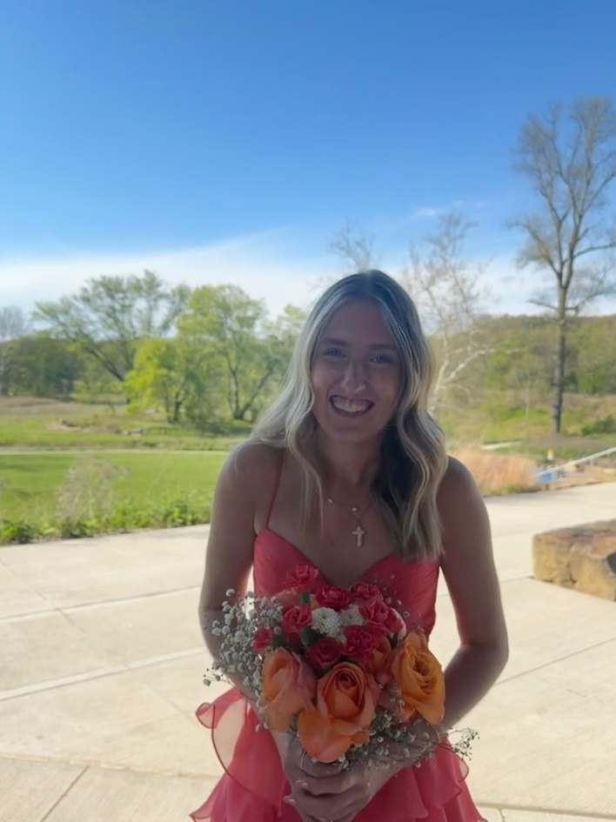
Faye
Schuller
Eckerd College
Marine Sciences

Slide 4
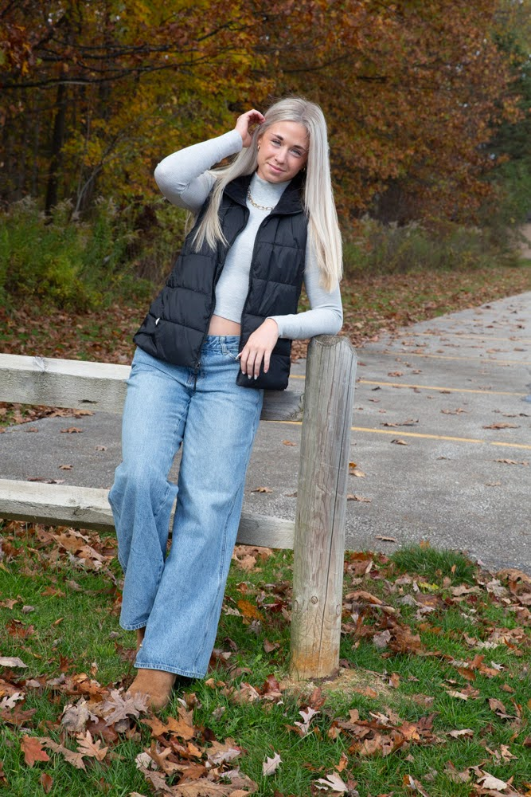
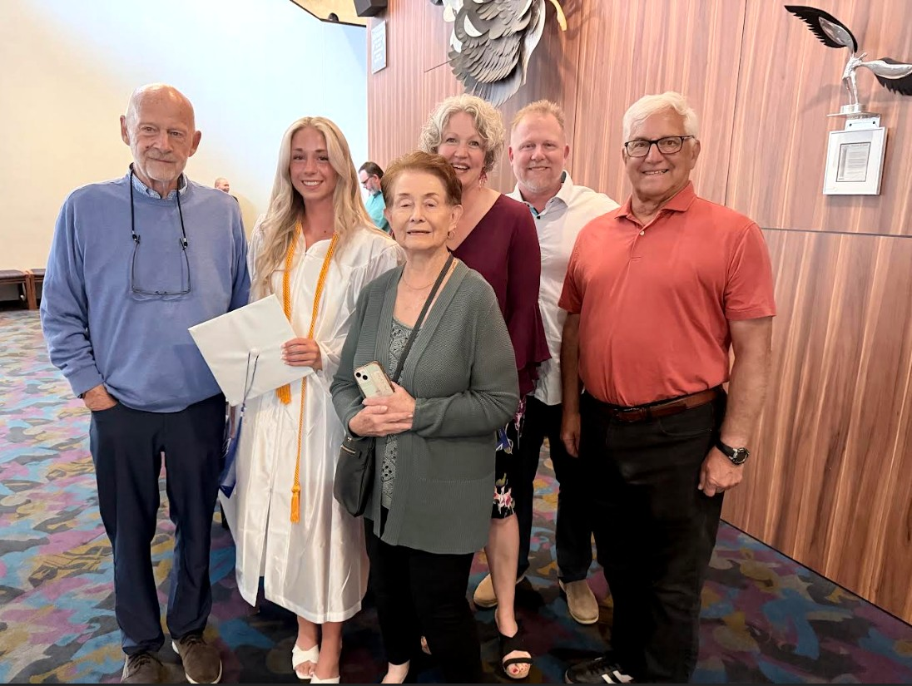
Kylee Hope
Zamecnik
Miami Of Ohio
Study Kinesiology & Run Track

Slide 5
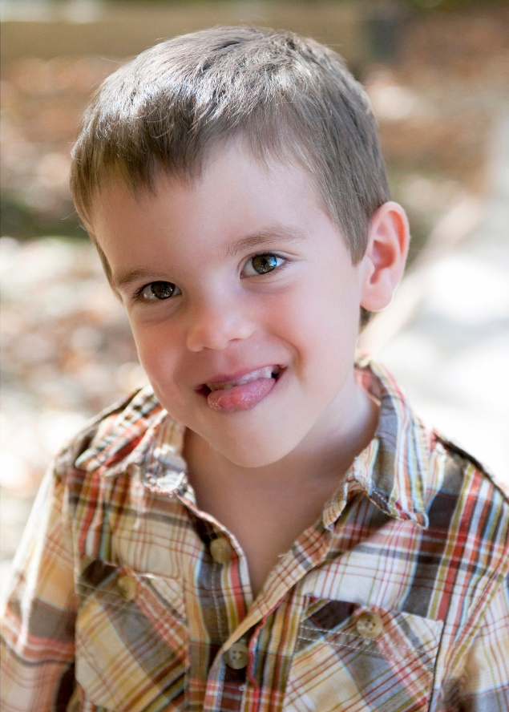
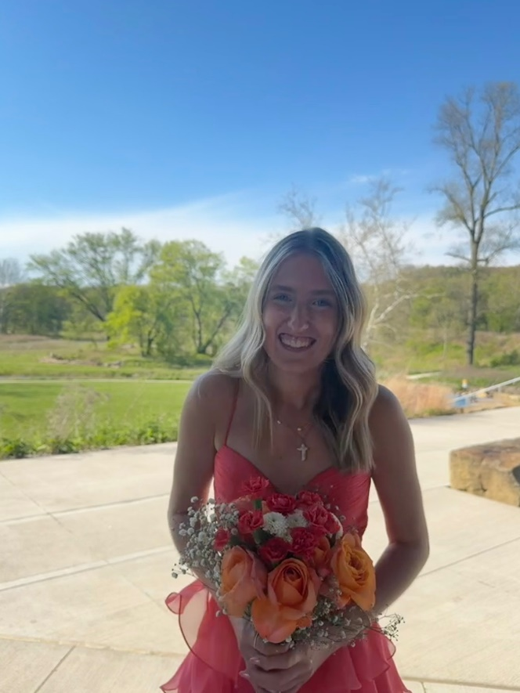
Class of 2026
Oak River Church
Christian Schuller
Bowling Green State University
Business Management
Faye Schuller
Eckerd College
Marine Sciences
Kylee Hope Zamecnik
Miami Of Ohio
Study Kinesiology & Run Track

