Slide 1

Lord Jesus Christ
October 25, 2026

Slide 2
Lord Jesus Christ
Lord: (kyrios) master or ruler; one who has power and exercises it Hebrew equivalent is “Adonai” – one of the titles for God
Jesus: (lesous) Yahweh is salvation; to save
derived from Hebrew word “Yeshua”
Christ: (Christos) anointed one; one of divine ordination Hebrew equivalent is “Messiah”

Slide 3
Used together, “Lord Jesus Christ” demonstrates a central belief in both His deity and humanity, as well as His authority to rule.
  “The early church, facing persecution and theological challenges, embraced the authority of ‘Lord Jesus Christ’ to unify believers in faith and resilience. These titles held power as they aligned the Christian narrative with the sovereignty of God previously established in the Jewish scriptures.” Pastor David (biblestudyforyou.com)

Slide 4
Romans 5:1-5 ^{ICB}
    ¹We have been made right with God because of our faith. So we have peace with God through our Lord Jesus Christ. ²Through our faith, Christ has brought us into that blessing of God’s grace that we now enjoy. And we are happy because of the hope we have of sharing God’s glory. ³And we also have joy with our troubles because we know that these troubles produce patience. ⁴And patience produces character, and character produces hope. ⁵And this hope will never disappoint us, because God has poured out his love to fill our hearts. God gave us his love through the Holy Spirit, whom God has given to us.

Slide 5
Romans 5:1-5 ^{ICB}
  1. made right with God – peace with God
  2. enjoy the gift of God’s grace
  3. happy because of hope
  4. joy with troubles because of benefits
  5. hearts filled with God’s love

Slide 6
Corinthians 1:4-10 ^{ICB}
    ⁴I always thank my God for you because of the grace that God has given you in Christ Jesus. ⁵In Jesus you have been blessed in every way, in all your speaking and in all your knowledge. ⁶The truth about Christ has been proved in you. ⁷So you have every gift from God while you wait for our Lord Jesus Christ to come again. ⁸Jesus will keep you strong until the end. He will keep you strong, so that there will be no wrong in you on the day our Lord Jesus Christ comes again. ⁹God is faithful. He is the One who has called you to share life with his Son, Jesus Christ our Lord.

Slide 7
Corinthians 1:4-10 ^{ICB}
    ¹⁰I beg you, brothers, in the name of our Lord Jesus Christ. I beg that all of you agree with each other, so that you will not be divided into groups. I beg that you be completely joined together by having the same kind of thinking and the same purpose.

Slide 8
Corinthians 1:4-10 ^{ICB}
  6. blessed (made rich) in every way, in all speaking and knowledge
  7. truth of Christ proven in us
  8. have every gift from God while we wait for Jesus’ return
  9. strong to the end, with no wrong in us at His return
  10. cornerstone of unity – same kind of thinking and same purpose

Slide 9

Lord Jesus Christ
1. made right with God – peace with God
2. enjoy the gift of God’s grace
3. happy because of hope
4. joy with troubles because of benefits
5. hearts filled with God’s love
6. blessed (made rich) in every way, in all speaking and knowledge
7. truth of Christ proven in us
8. have every gift from God while we wait for Jesus’ return
9. strong to the end, with no wrong in us at His return
10. cornerstone of unity – same kind of thinking and same purpose

Slide 10
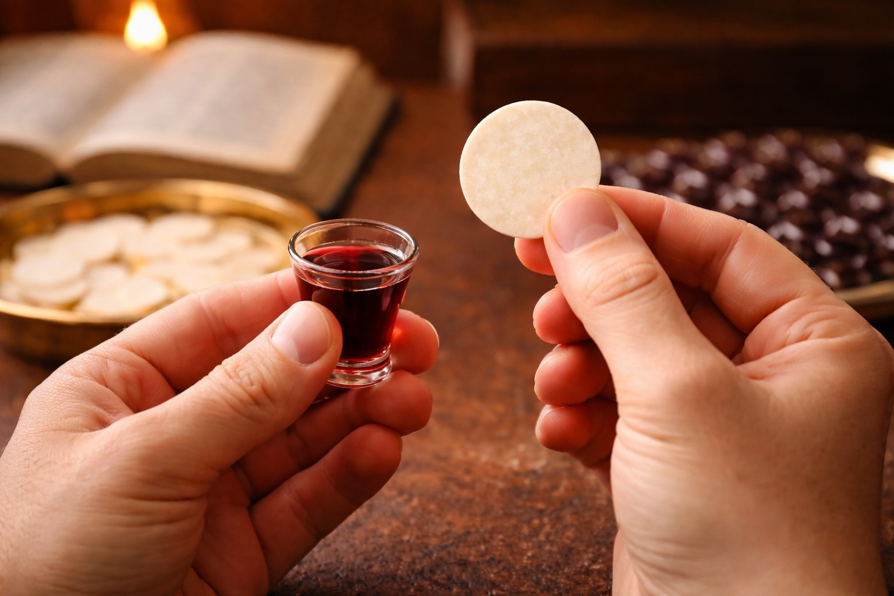

Family Communion

