Slide 1
Why Deeper?
July 12

Slide 2
Ezekiel 47:1-5 ^{NLT}
  ¹In my vision, the man brought me back to the entrance of the Temple. There I saw a stream flowing east from beneath the door of the Temple and passing to the right of the altar on its south side. ²The man brought me outside the wall through the north gateway and led me around to the eastern entrance. There I could see the water flowing out through the south side of the east gateway. ³Measuring as he went, he took me along the stream for 1,750 feet and then led me across. The water was up to my ankles. ⁴He measured off another 1,750 feet and led me across again. This time the water was up to my knees. After another 1,750 feet, it was up to my waist. ⁵Then he measured another 1,750 feet, and the river was too deep to walk across. It was deep enough to swim in, but too deep to walk through.

Slide 3
Ezekiel 47:1-5 ^{NLT}
I. GOD IS THE SOURCE OF THE RIVER
II. THE FURTHER WE GO, THE DEEPER IT GETS

Slide 4
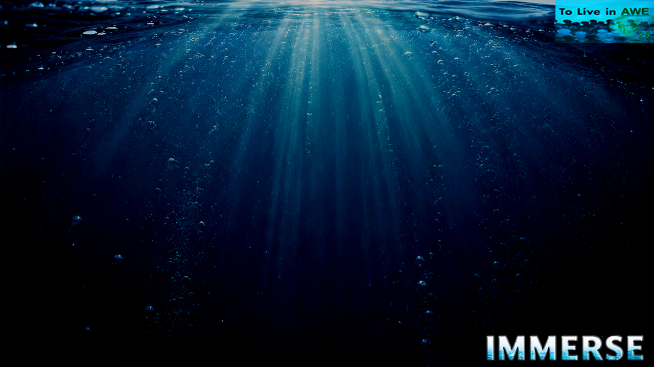
Ezekiel 47:6-11 ^{NLT}
  ⁶He asked me, “Have you been watching, son of man?” Then he led me back along the riverbank. ⁷When I returned, I was surprised by the sight of many trees growing on both sides of the river. ⁸Then he said to me, “This river flows east through the desert into the valley of the Dead Sea. The waters of this stream will make the salty waters of the Dead Sea fresh and pure. ⁹There will be swarms of living things wherever the water of this river flows. Fish will abound in the Dead Sea, for its waters will become fresh. Life will flourish wherever this water flows. ¹⁰Fishermen will stand along the shores of the Dead Sea. All the way from En-gedi to En-eglaim, the shores will be covered with nets drying in the sun. Fish of every kind will fill the Dead Sea, just as they fill the Mediterranean. ¹¹But the marshes and swamps will not be purified; they will still be salty.

Slide 5
Ezekiel 47:6-11 ^{NLT}
III. WHY? TO TURN SALTY WATER INTO FRESH WATER
IV. WHY? FOR LIFE THAT FLOURISHES

Slide 6
Ezekiel 47:12 ^{NLT}
  ¹²Fruit trees of all kinds will grow along both sides of the river. The leaves of these trees will never turn brown and fall, and there will always be fruit on their branches. There will be a new crop every month, for they are watered by the river flowing from the Temple. The fruit will be for food and the leaves for healing.”
V. WHY? FOR FOOD AND HEALING

Slide 7
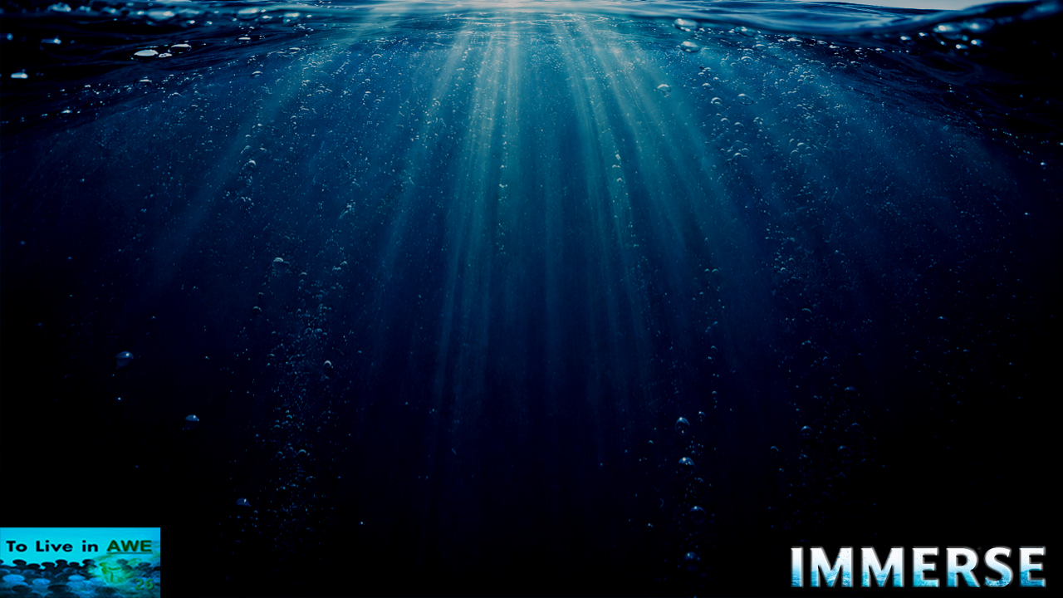
Why Deeper?
I. GOD IS THE SOURCE OF THE RIVER
II. THE FURTHER WE GO, THE DEEPER IT GETS
III. WHY? TO TURN SALTY WATER INTO FRESH WATER
IV. WHY? FOR LIFE THAT FLOURISHES
V. WHY? FOR FOOD AND HEALING

Slide 8
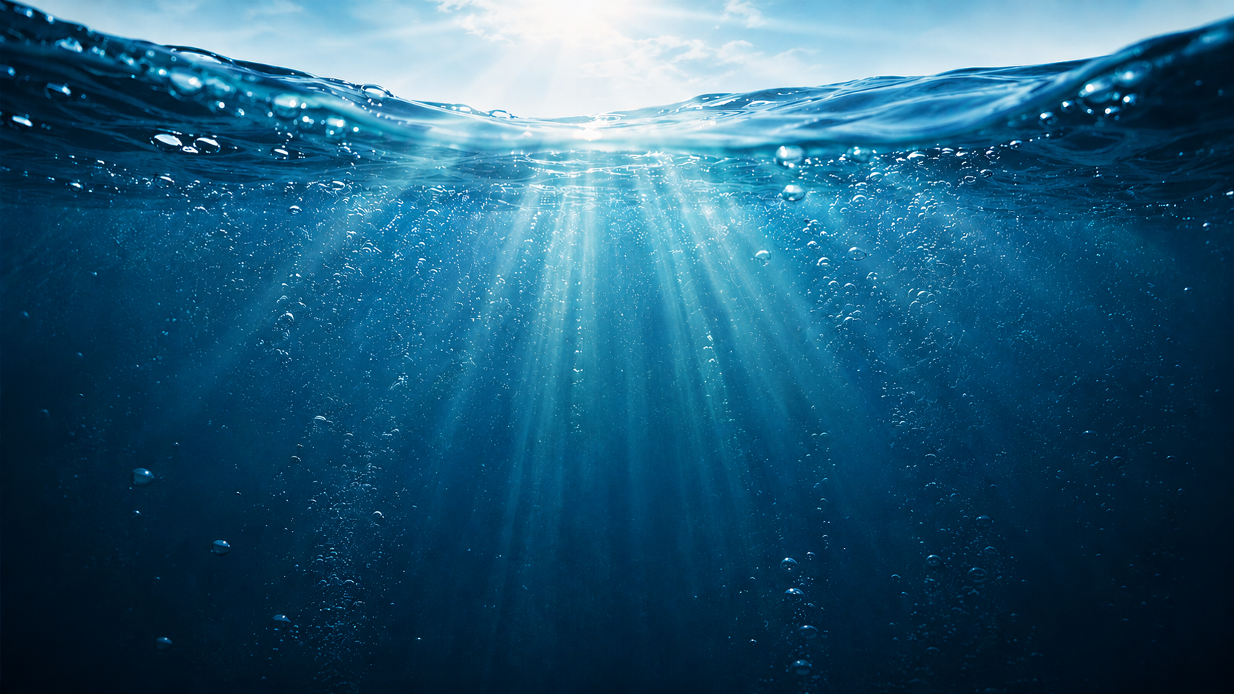
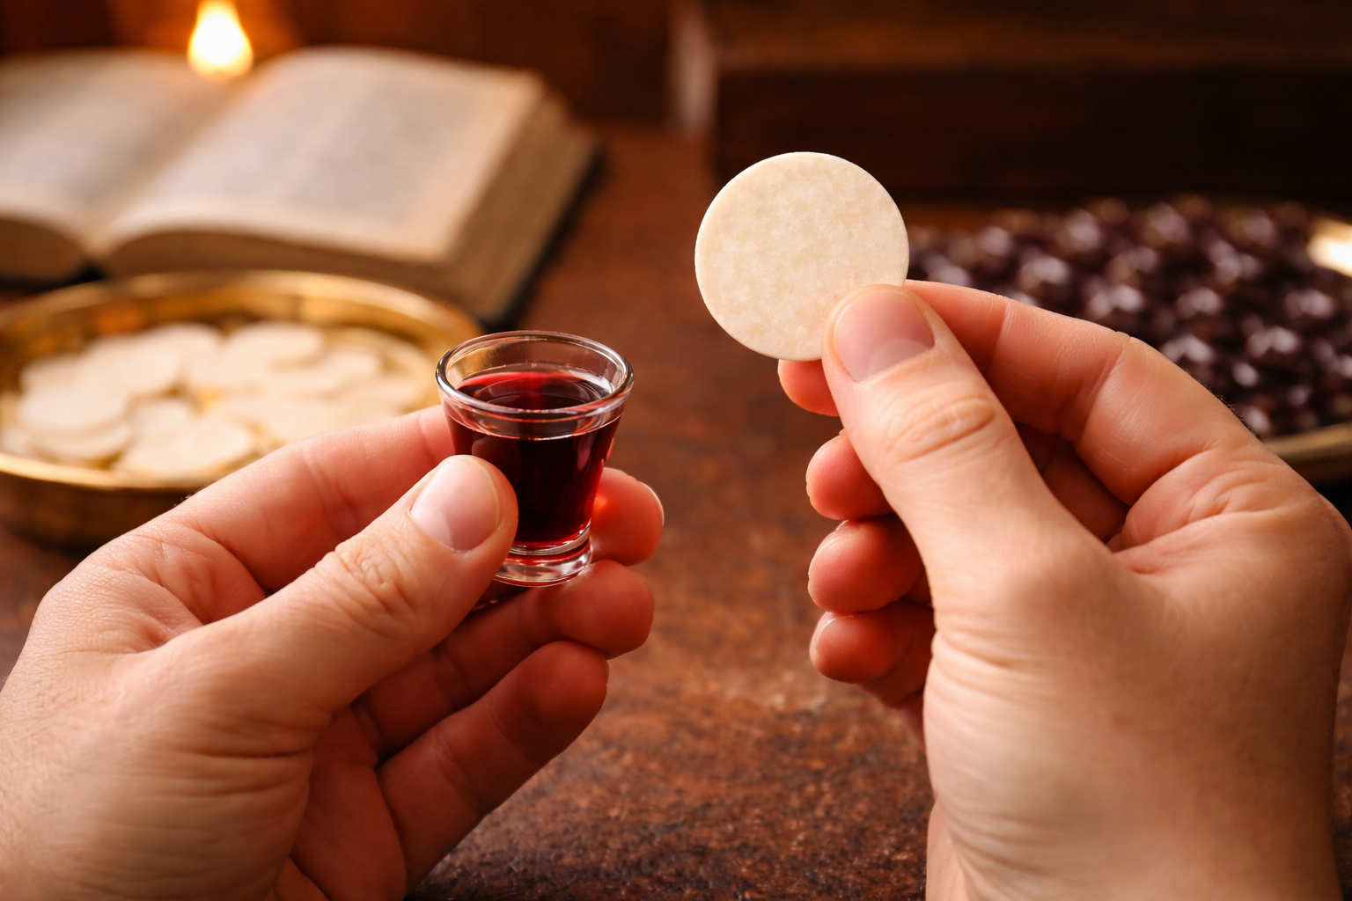
Family Communion

