Slide 1
The Overwhelming Embracer
February 01, 2026

Slide 2
I. God's PURE LOVE is Overwhelming
Ephesians 3:14-16 ^{MSG}
My response is to get down on my knees before the Father, this magnificent Father who parcels out all heaven and earth. I ask him to strengthen you by his Spirit—not a brute strength but a glorious inner strength—that Christ will live in you as you open the door and invite him in.

Slide 3
I. God's PURE LOVE is Overwhelming
Ephesians 3:17-19 ^{MSG}
And I ask him that with both feet planted firmly on love, you’ll be able to take in with all followers of Jesus the extravagant dimensions of Christ’s love. Reach out and experience the breadth! Test its length! Plumb the depths! Rise to the heights! Live full lives, full in the fullness of God.

Slide 4
II. God's PURE LOVE is Surrounding
Psalm 139:7–10 ^{MSG}
Is there anyplace I can go to avoid your Spirit? to be out of your sight? If I climb to the sky, you’re there! If I go underground, you’re there! If I flew on morning’s wings to the far western horizon, You’d find me in a minute— you’re already there waiting!

Slide 5
III. God's PURE LOVE is Unfailing
Romans 8:31-33 ^{MSG}
So, what do you think? With God on our side like this, how can we lose? If God didn’t hesitate to put everything on the line for us, embracing our condition and exposing himself to the worst by sending his own Son, is there anything else he wouldn’t gladly and freely do for us? And who would dare tangle with God by messing with one of God’s chosen? Who would dare even to point a finger?

Slide 6
III. God's PURE LOVE is Unfailing
Romans 8:34-35 ^{MSG}
The One who died for us—who was raised to life for us!—is in the presence of God at this very moment sticking up for us. Do you think anyone is going to be able to drive a wedge between us and Christ’s love for us? There is no way! Not trouble, not hard times, not hatred, not hunger, not homelessness, not bullying threats, not backstabbing, not even the worst sins listed in Scripture:

Slide 7
III. God's PURE LOVE is Unfailing
Romans 8:36-39 ^{MSG}
They kill us in cold blood because they hate you. We’re sitting ducks; they pick us off one by one. None of this fazes us because Jesus loves us. I’m absolutely convinced that nothing—nothing living or dead, angelic or demonic, today or tomorrow, high or low, thinkable or unthinkable—absolutely nothing can get between us and God’s love because of the way that Jesus our Master has embraced us.

Slide 8
IV. God's PURE LOVE is Transforming
1 John 4:19 ^{ERV}
We love because God first loved us.
1 Peter 1:22 ^{ERV}
You have made yourselves pure by obeying the truth. Now you can have true love for your brothers and sisters. So love each other deeply—with all your heart.

Slide 9
IV. God's PURE LOVE is Transforming
Romans 12:1 ^{MSG}
So here’s what I want you to do, God helping you: Take your everyday, ordinary life—your sleeping, eating, going-to-work, and walking-around life—and place it before God as an offering. Embracing what God does for you is the best thing you can do for him.

Slide 10
IV. God's PURE LOVE is Transforming
Romans 12:2 ^{MSG}
Don’t become so well-adjusted to your culture that you fit into it without even thinking. Instead, fix your attention on God. You’ll be changed from the inside out. Readily recognize what he wants from you, and quickly respond to it. Unlike the culture around you, always dragging you down to its level of immaturity, God brings the best out of you, develops well-formed maturity in you.

Slide 11
IV. God's PURE LOVE is Transforming
Ephesians 5:1-2 ^{MSG}
Watch what God does, and then you do it, like children who learn proper behavior from their parents. Mostly what God does is love you. Keep company with him and learn a life of love. Observe how Christ loved us. His love was not cautious but extravagant. He didn’t love in order to get something from us but to give everything of himself to us. Love like that.

Slide 12
The Overwhelming Embracer
John 3:16 ^{NKJV}
For God so loved the world that He gave His only begotten Son, that whoever believes in Him should not perish but have everlasting life.

Slide 13
Whoever Believes In Him
Anyone can do that by trusting Jesus enough to say “I give up.”
I cannot fix myself and I cannot be good enough.
I come to You as I am and invite You to take control of my life.
I surrender my will to Your will.
Lord SAVE me and HELP me live the rest of my days in Your Overwhelming Embrace.
If you say that in your heart and mean it, welcome to God’s family.

Slide 14
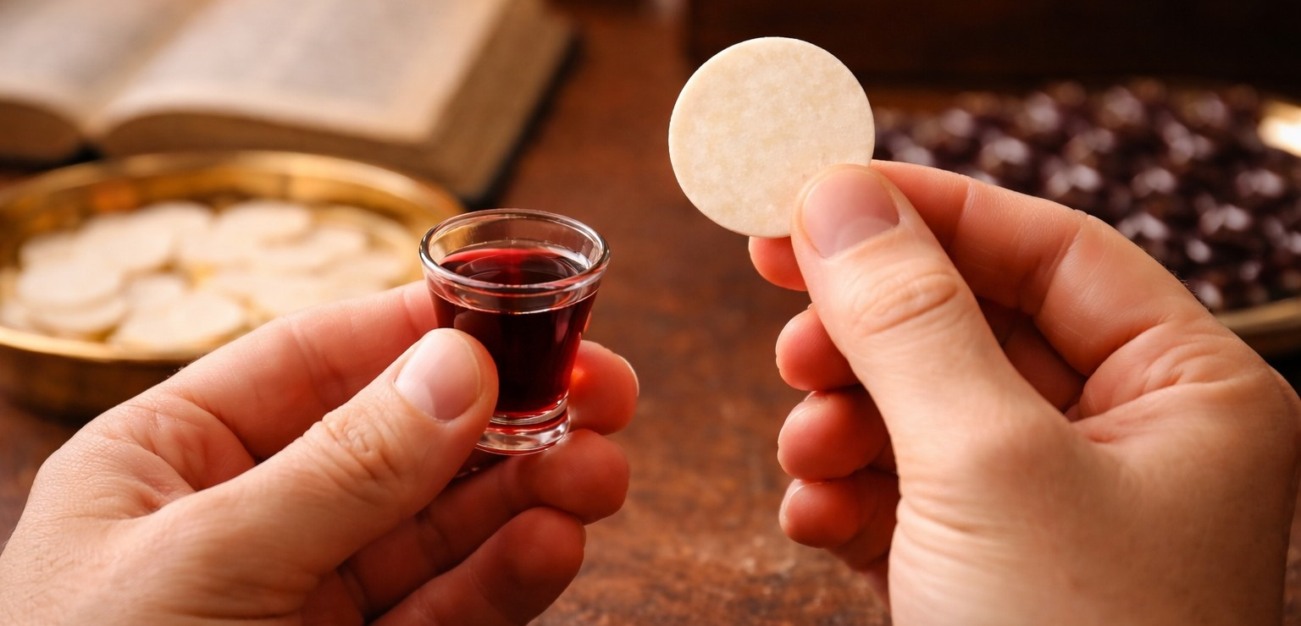
Family Communion (served by the ushers)

Slide 15

The Overwhelming Embracer
I. God's is Overwhelming
II. God's is Surrounding
III. God's is Unfailing
IV. God's is Transforming

